Slide 1


Analog Computer
EN2091 - Laboratory Practice and Projects

Slide 2
About our device
Able to carry out addition, subtraction and multiplication of two Signals. Mainly it allows to do those operation for square waveform, triangle waveform, sinusoidal waveform.
Comprised of OPAMPs
Able to perform computations frequency range of 1Hz – 10 kHz
Controllable gain

Slide 3
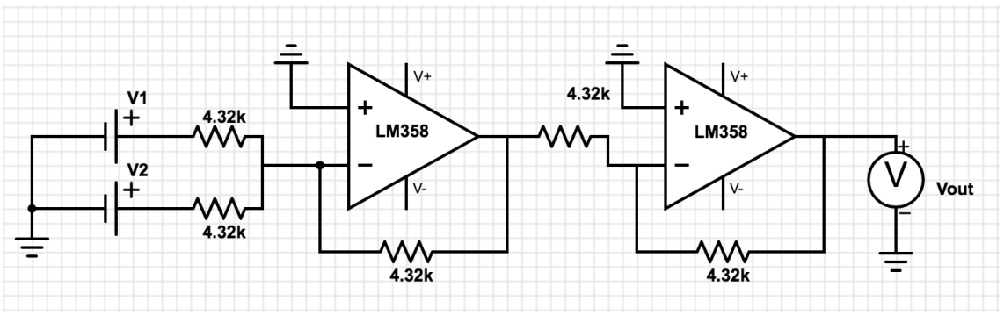
Adder Circuit

Slide 4
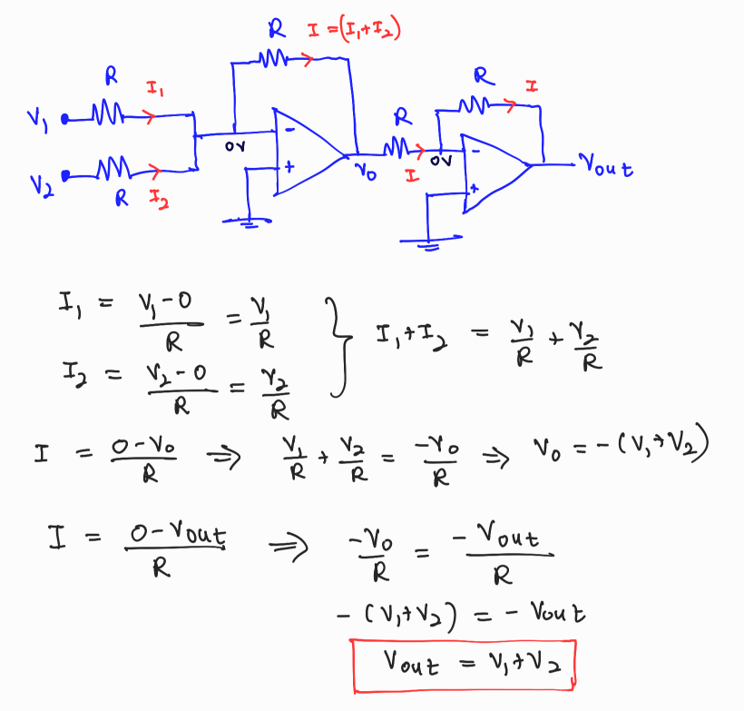
Derivation

Slide 5
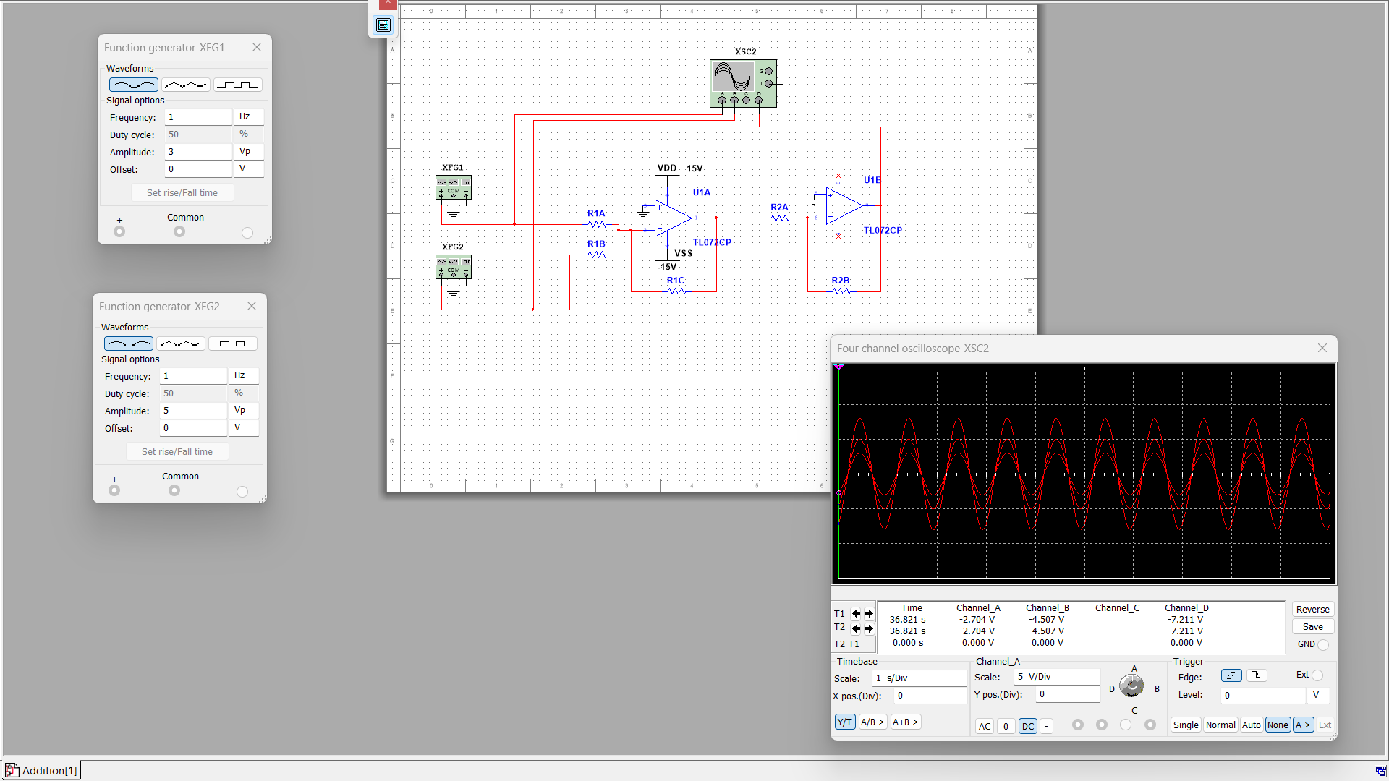
Simulation Results

Slide 6
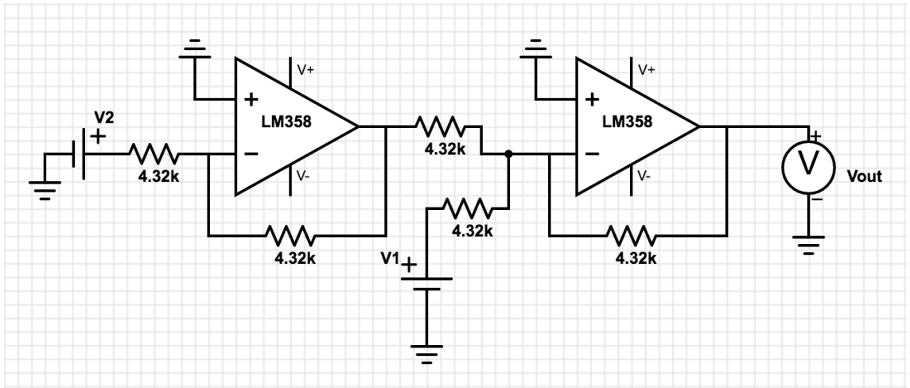
Subtractor Circuit

Slide 7
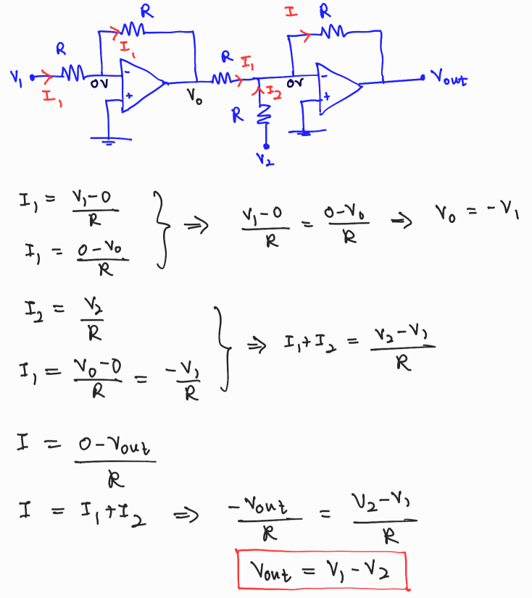
Derivation

Slide 8
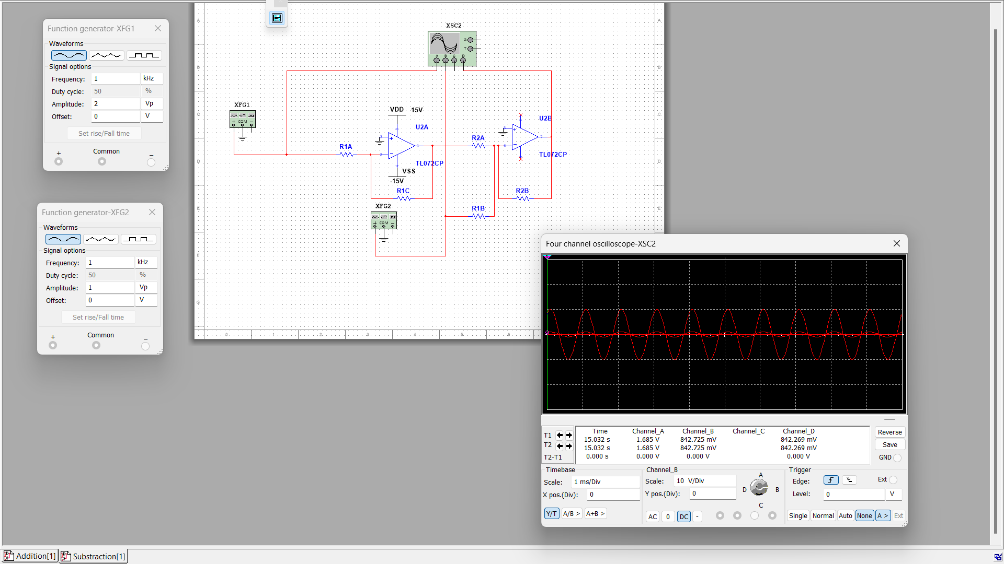
Simulation Results

Slide 9
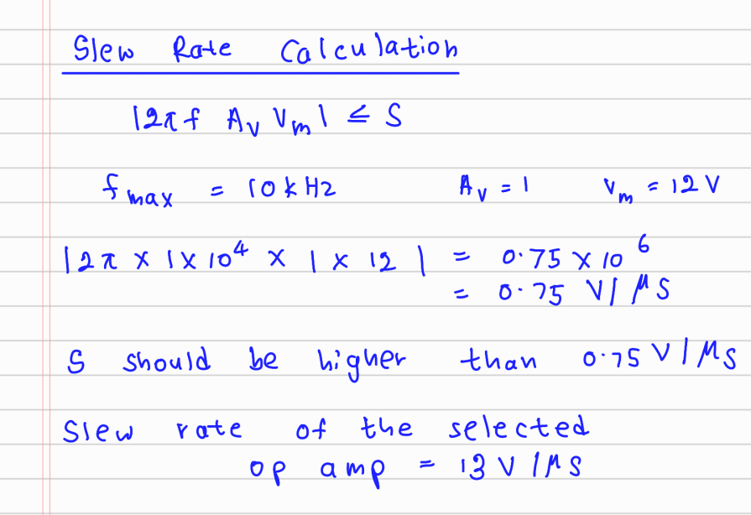
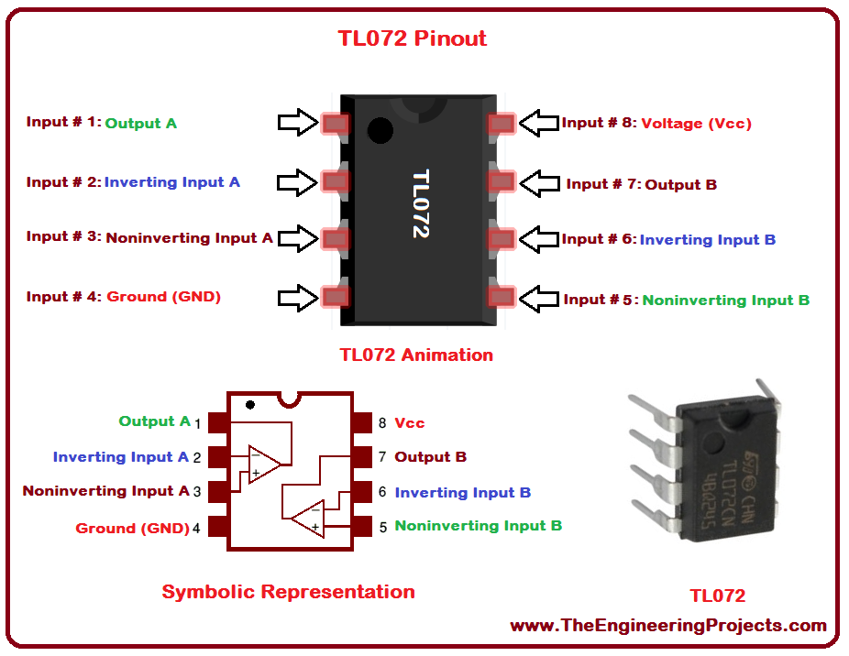
Selected Opamp
For both adder and subtracter circuits We used TL072 OPAMPS .
Has high slew rate and high gain.

Slide 10
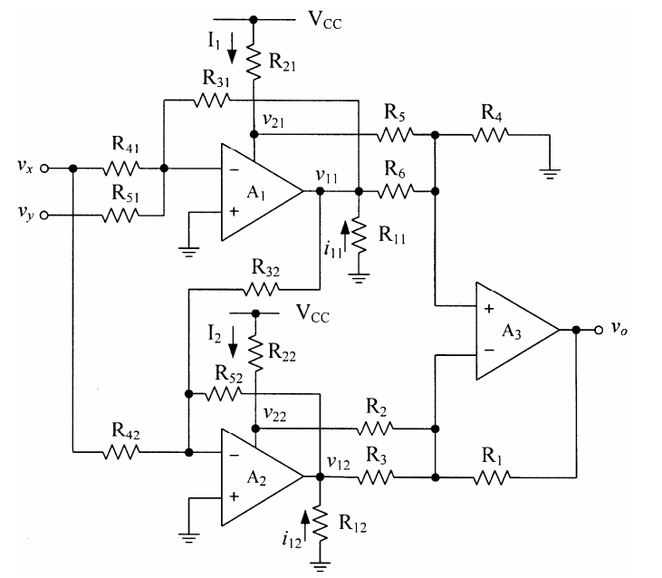
Multiplier Circuit

Slide 11
How Multiplier circuit works
One OpAmp circuit will add the two signals using an adder circuit (Vx+Vy)
Second OpAmp will subtract the two signals using a subtractor circuit.(Vx-Vy)
Then the two outputs are squared
Finally we get the difference between the squared outputs using a differential amplifier.
(V_{x}+V_{y})²-(V_{x}-V_{y})² = 4V_{x}V_{y}

Slide 12
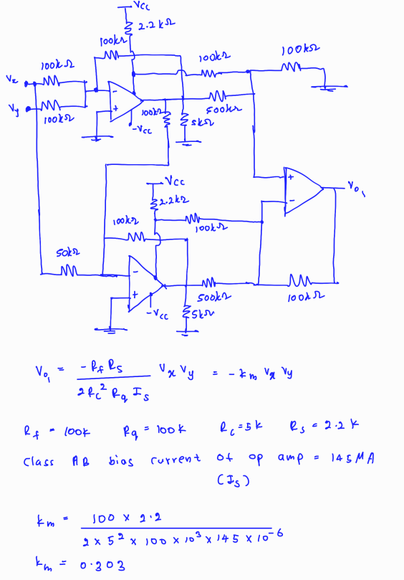
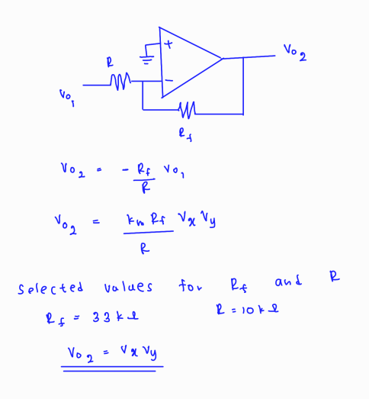
Multiplier Circuit Calculations

Slide 13
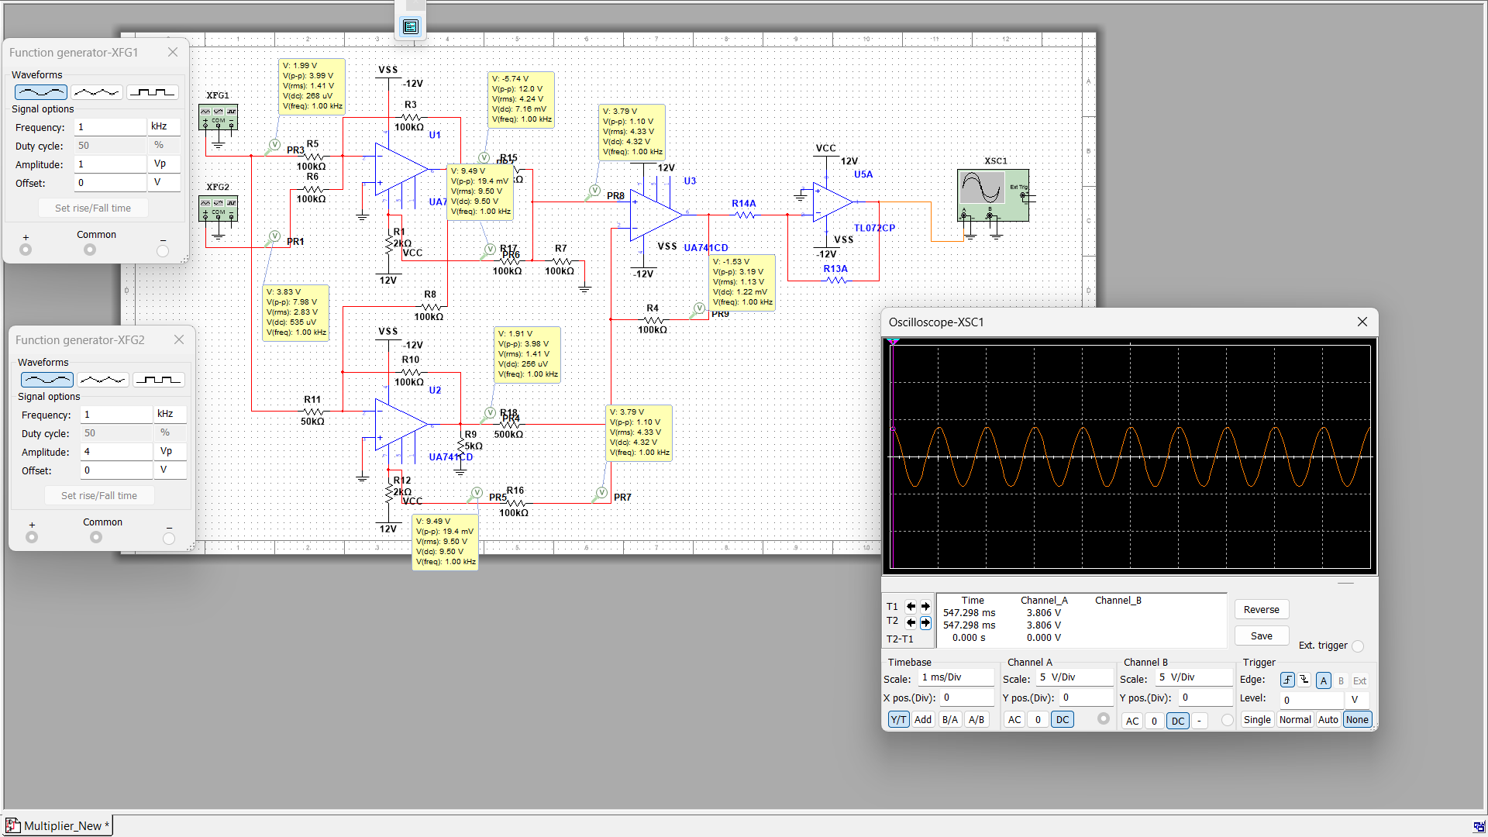
Simulation Results

Slide 14
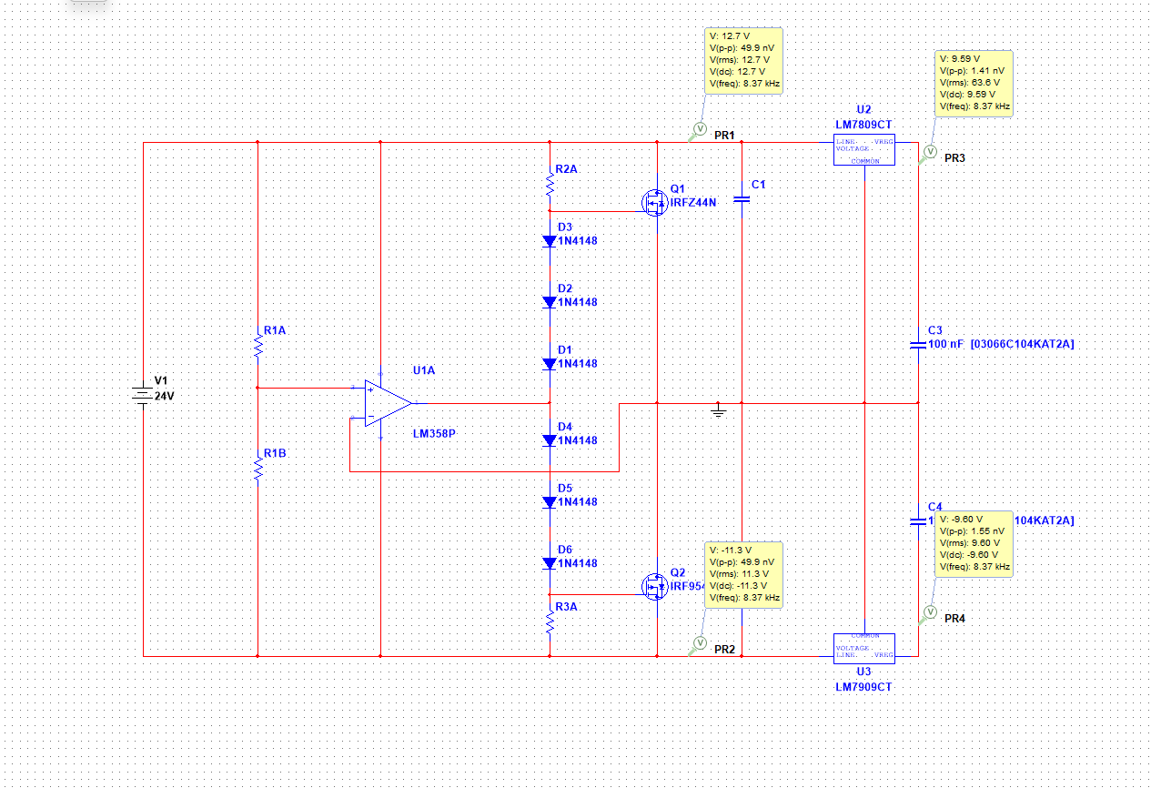
Power Supply circuit

Slide 15
For the power supply
We are using a DC adapter here.
Then a splitter circuit is used to split the voltage .
After that LM7809 and LM7909 voltage regulators are used to regulate the voltage.

Slide 16
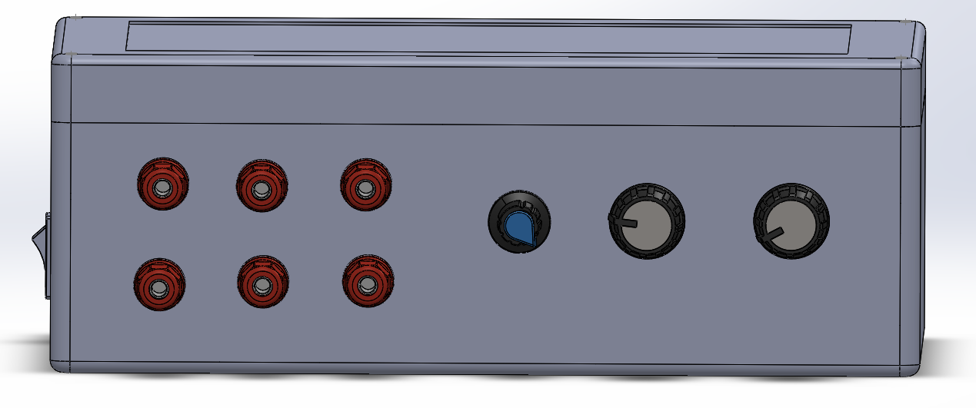
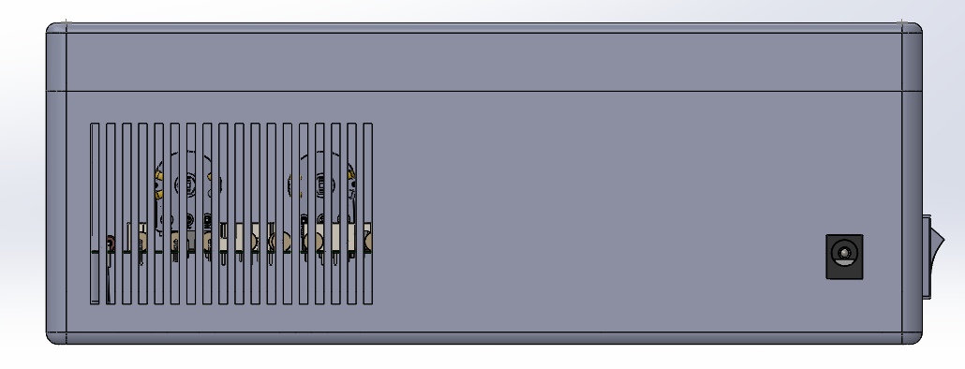
Solid Works Design
(Enclosure Design)
Front View
Back View

Slide 17
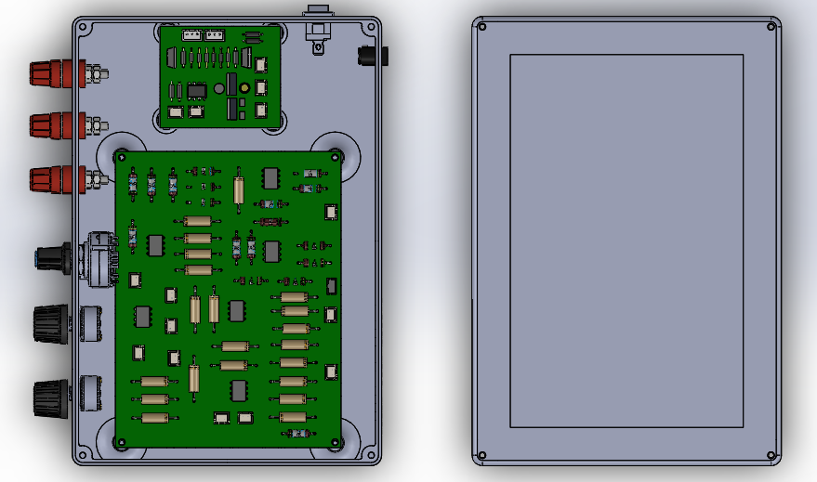
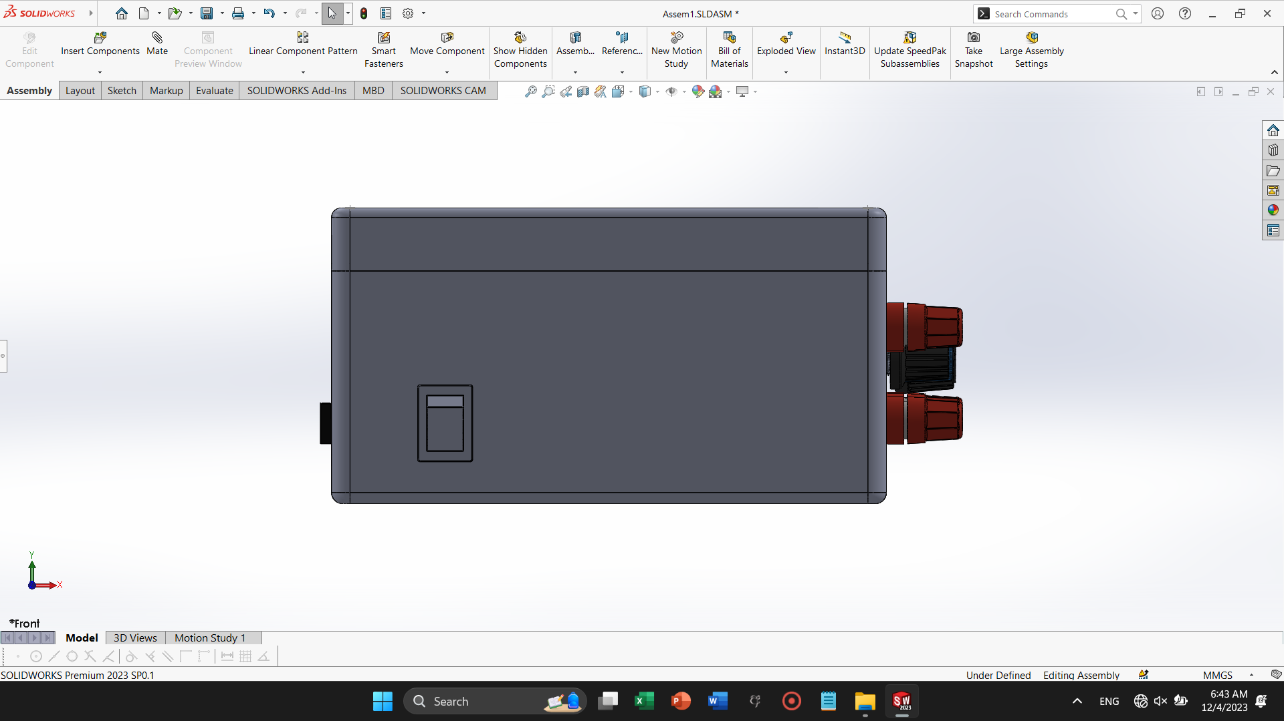
Solid Works Design
(Enclosure Design)
Top Inner View
Side View

Slide 18
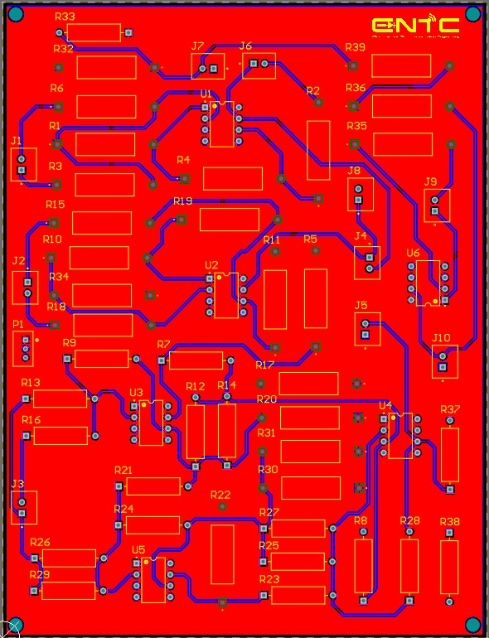
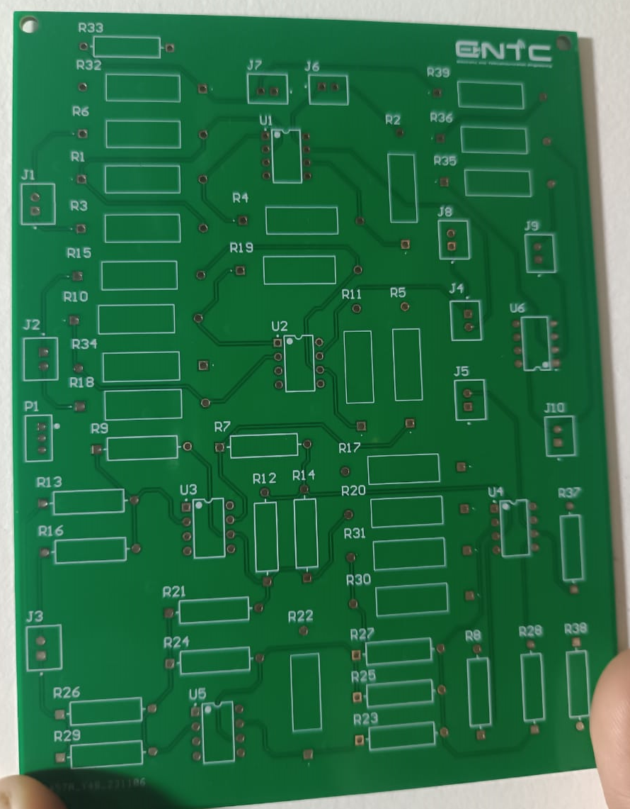
Main PCB Design
(Altium Design)

Slide 19
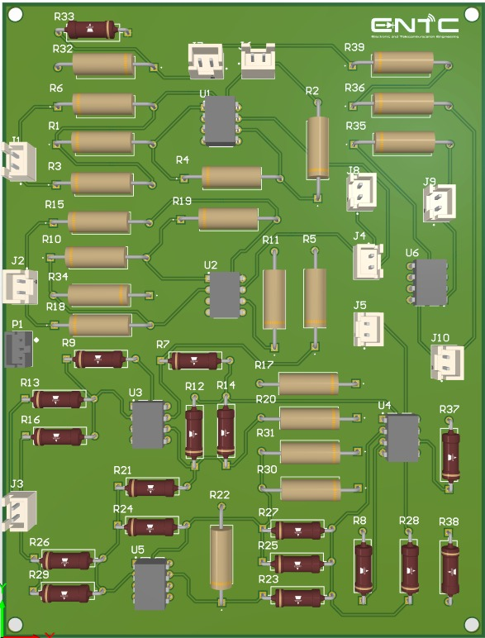
Power SuppLy PCB Design
(Altium Design)

Slide 20
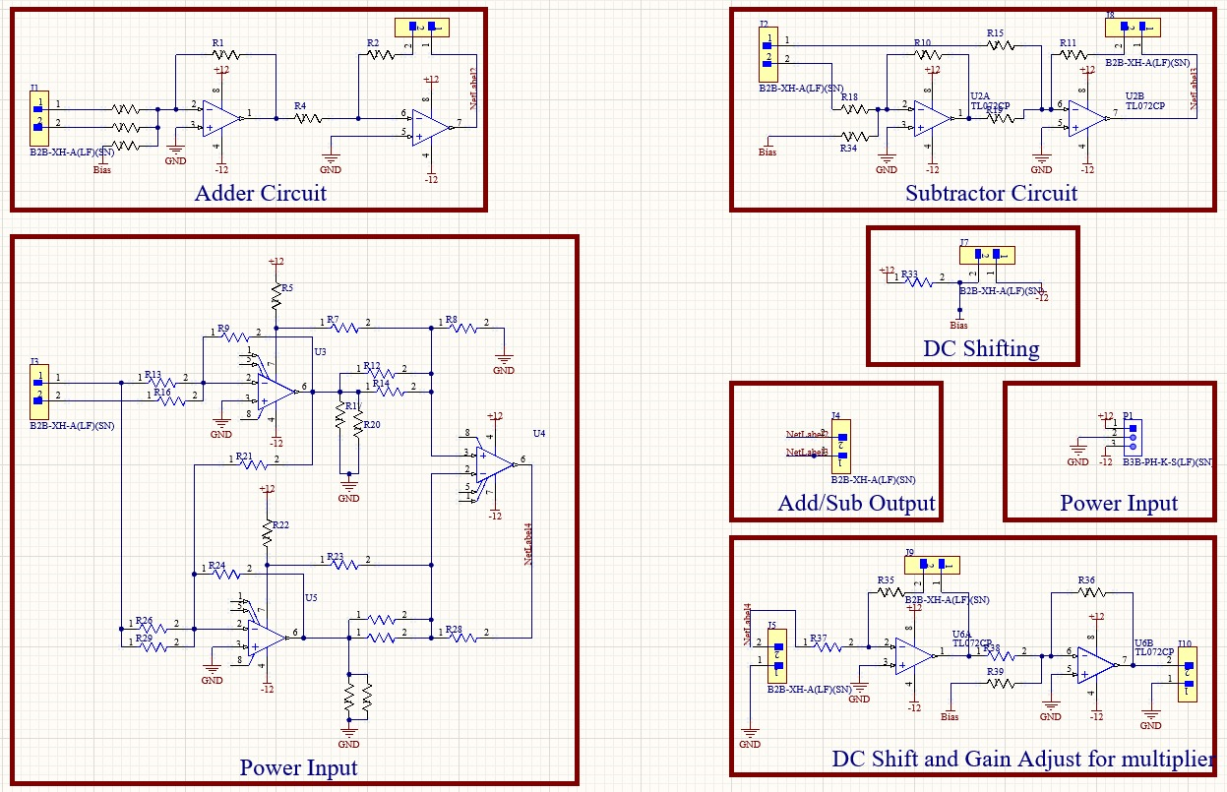
Schematic Diagrams

Slide 21
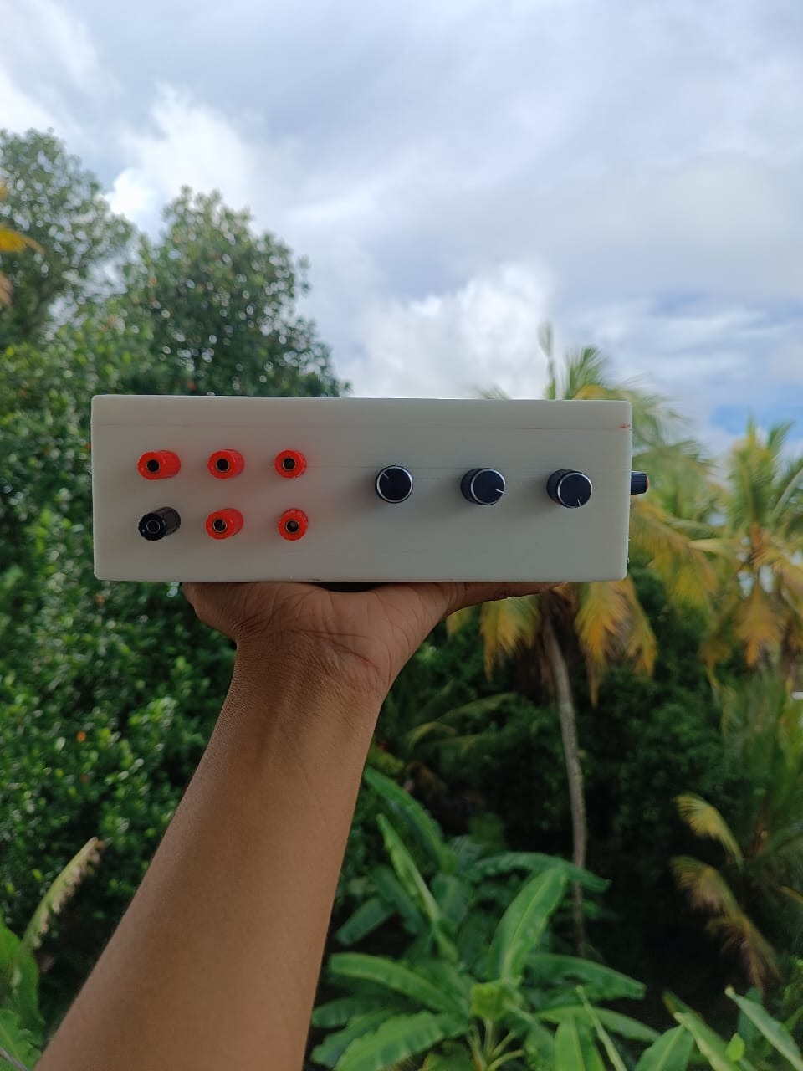
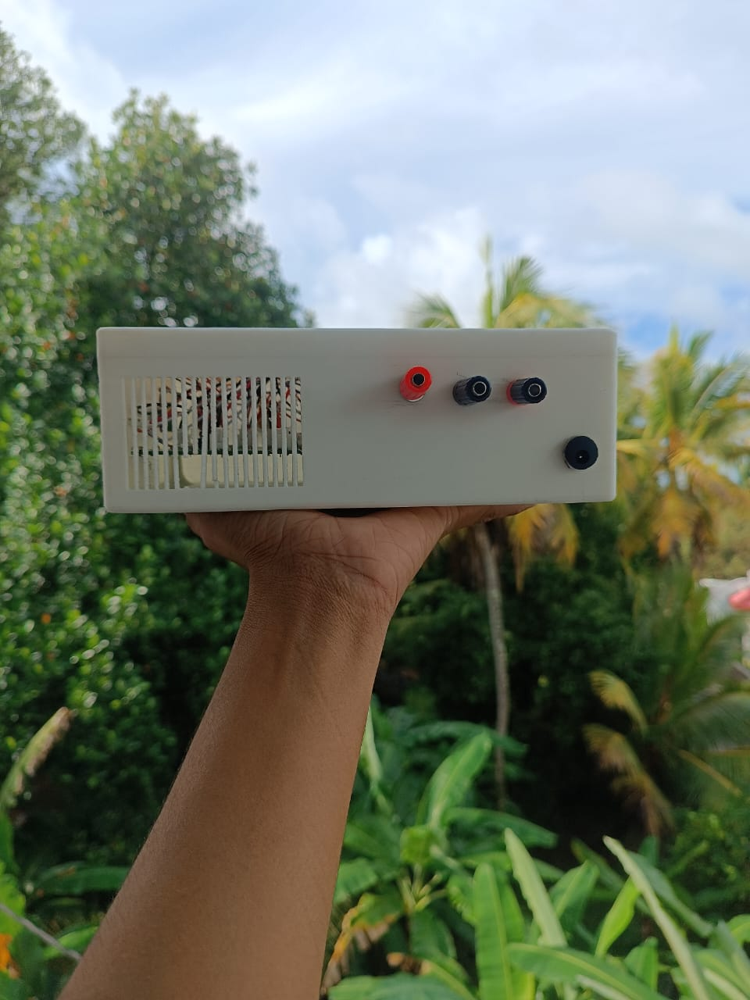
Final Product
Front View
Back View

Slide 22
Task Allocation
Index Number | Name | Task
210037G | Amarathunga D.N. | Power PCB design, Testing, Circuit Design, Report Writing
210325M | Kuruppu M.P | Component Assembling, Testing, Circuit Design, Report Writing
210446J | Pasira I.P.M | Main PCB design, Testing, Circuit Design, Report Writing
210454G | Peiris D.L.C.J. | Enclosure Design, Testing, Circuit Design, Report Writing

Slide 23
Thank You !

